Slide 1
ITAC Learning Service - Overview
Provide isolated, secure, and scalable cloud-based learning environments.
Core Components:
- Learning Control Plane (LCP)
- Learning Data Plane (LDP)
- Learning API Service (LAS)
- Dynamic Volume Provisioning
- Security Architecture
- Toolkit Image Management
Technologies: Kubernetes (IKS), Istio, Prometheus, JupyterHub, AWS Cognito, Azure AD, Weka/VAST.

Slide 2
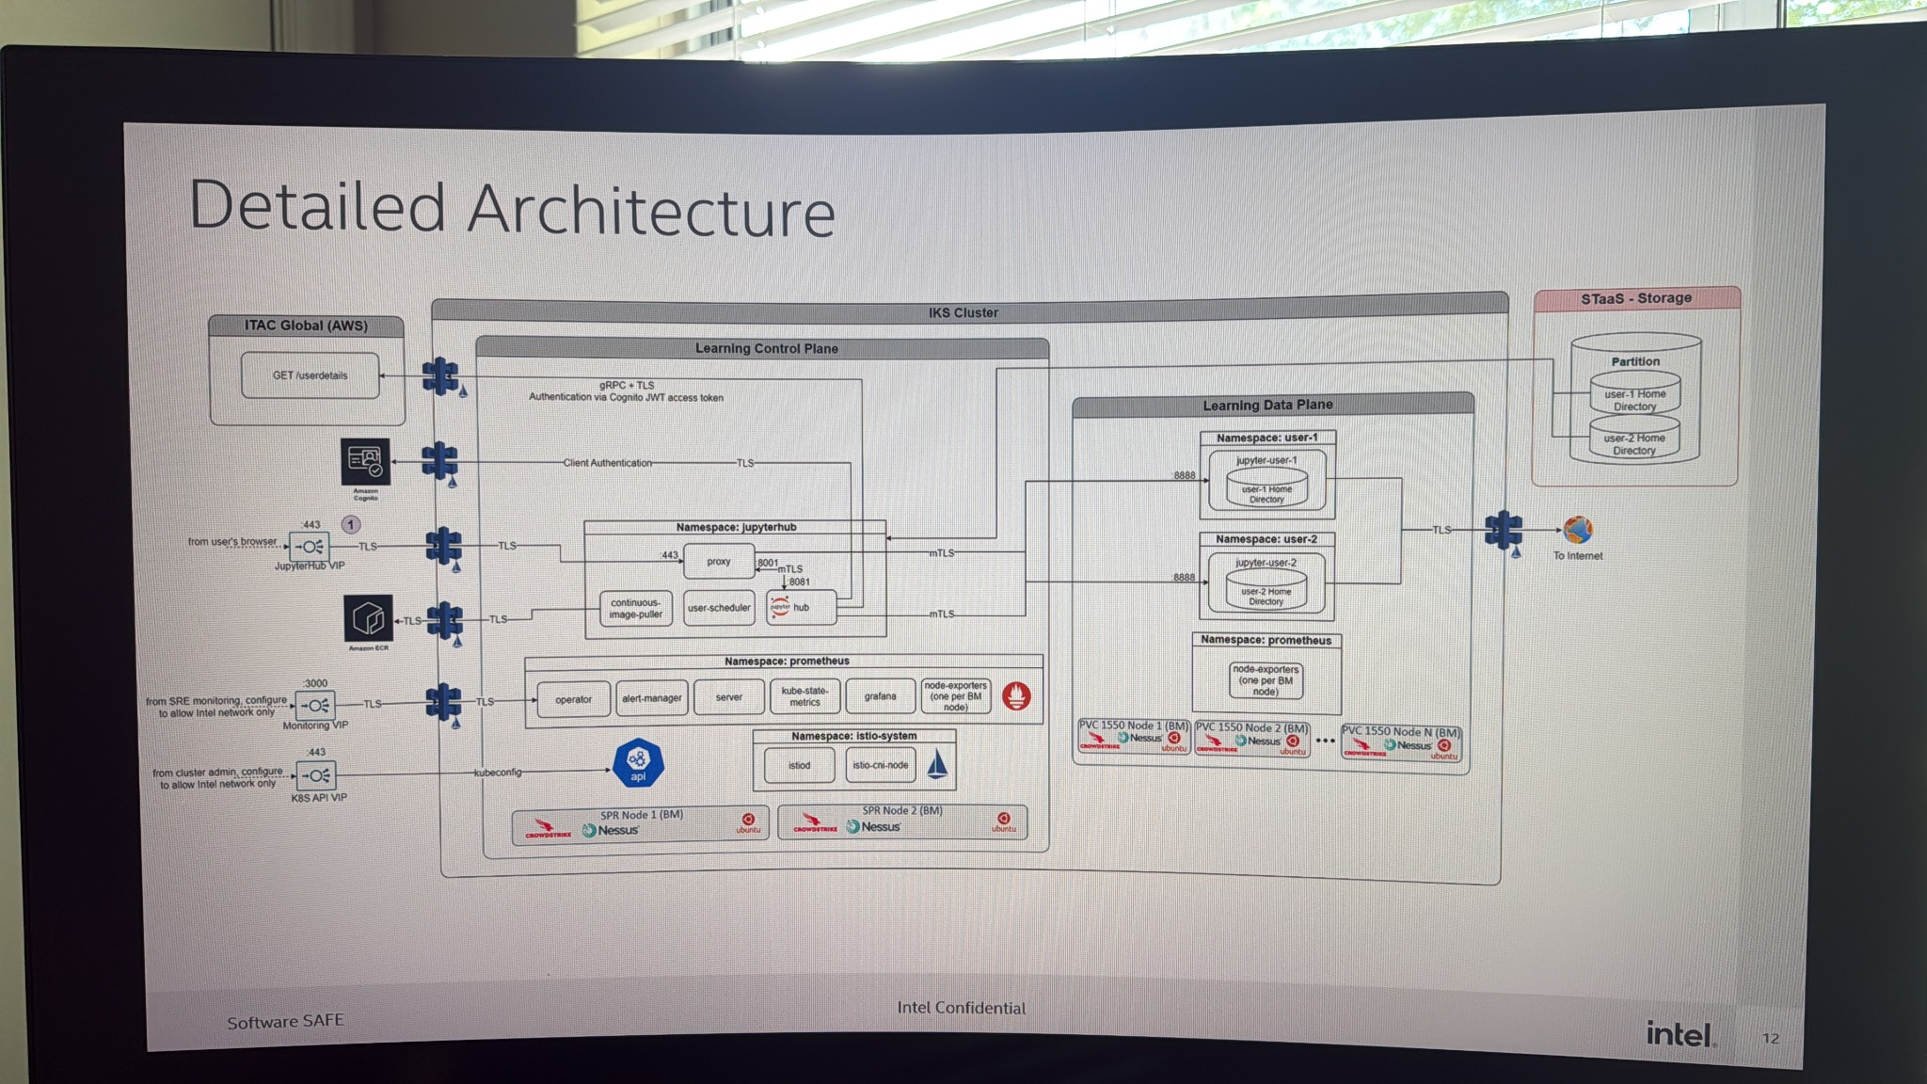
Detailed System Architecture
Learning Control Plane: Authentication, JupyterHub, Prometheus, Istio (mTLS).
Learning Data Plane: Namespaced isolation, user pods, persistent home directories.
Storage Layer: STaaS partitions per user with TLS-secured Weka/VAST backend.

Slide 3
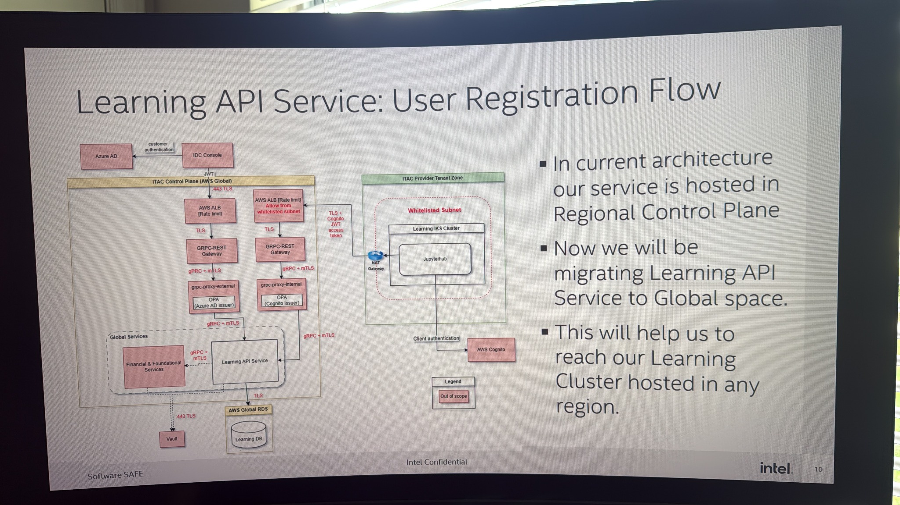
Learning API Service Architecture
Flow Summary:
1. Azure AD authentication
2. API calls via AWS ALB + gRPC Gateway
3. Learning API stores session data in AWS RDS
4. Cognito provides federated authentication.
Enhancement: Migration from regional to global control plane for multi-region scalability.

Slide 4
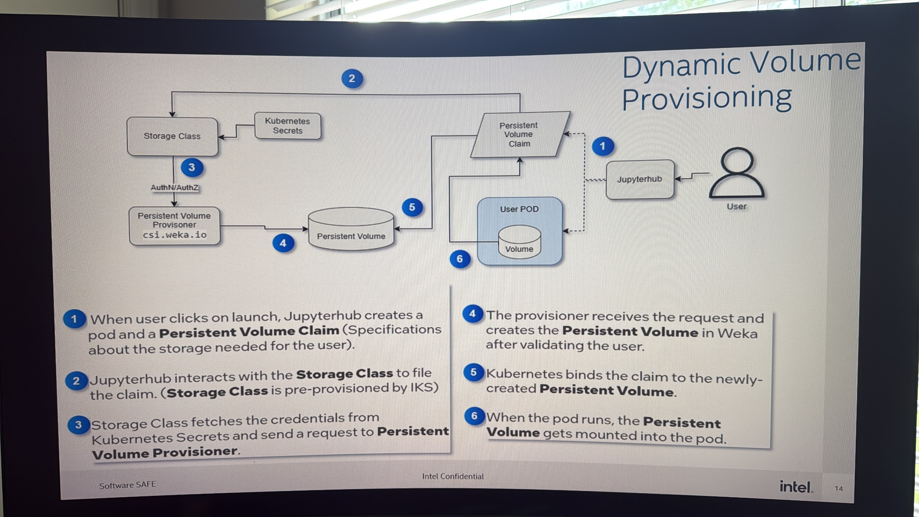
Dynamic Volume Provisioning (CSI Flow)
1. User triggers JupyterHub launch → PVC created
2. JupyterHub interacts with StorageClass
3. StorageClass retrieves credentials
4. Weka CSI provisions Persistent Volume
5. Kubernetes binds PVC→PV
6. Volume mounted into pod.
Driver: csi.weka.io

Slide 5
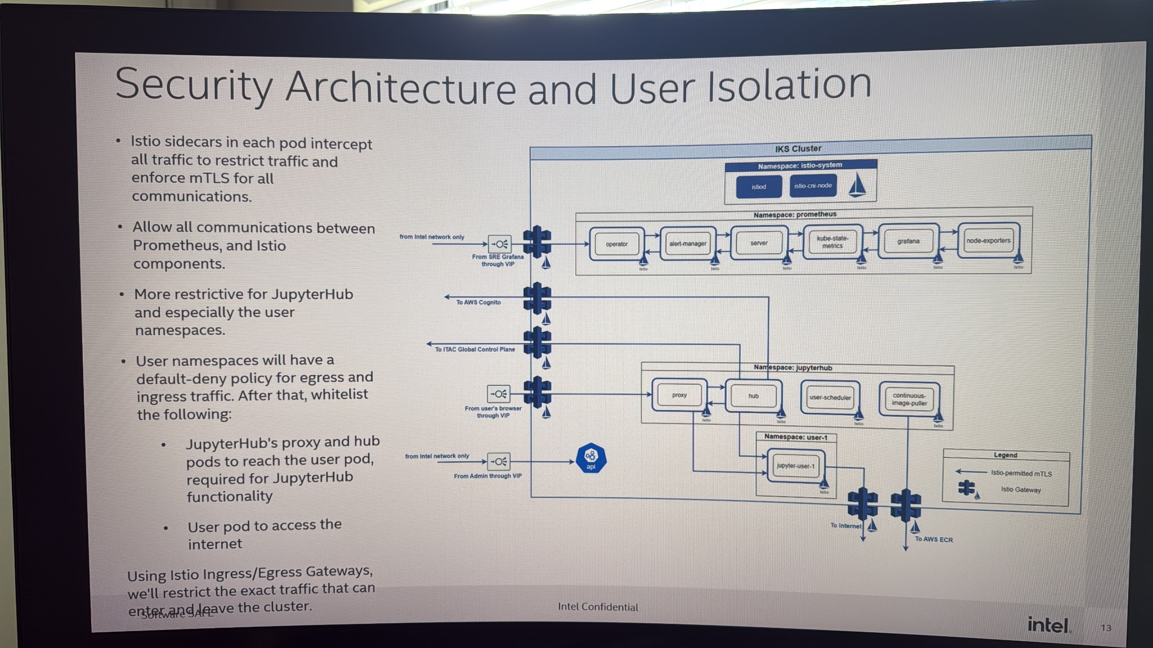
Security Architecture and User Isolation
Istio sidecars enforce mTLS for all traffic.
Default-deny ingress/egress for user namespaces.
JupyterHub pods whitelisted for minimal connectivity.
Outbound only to Cognito and ECR.
Ensures strong multi-tenant isolation and secure telemetry.

Slide 6
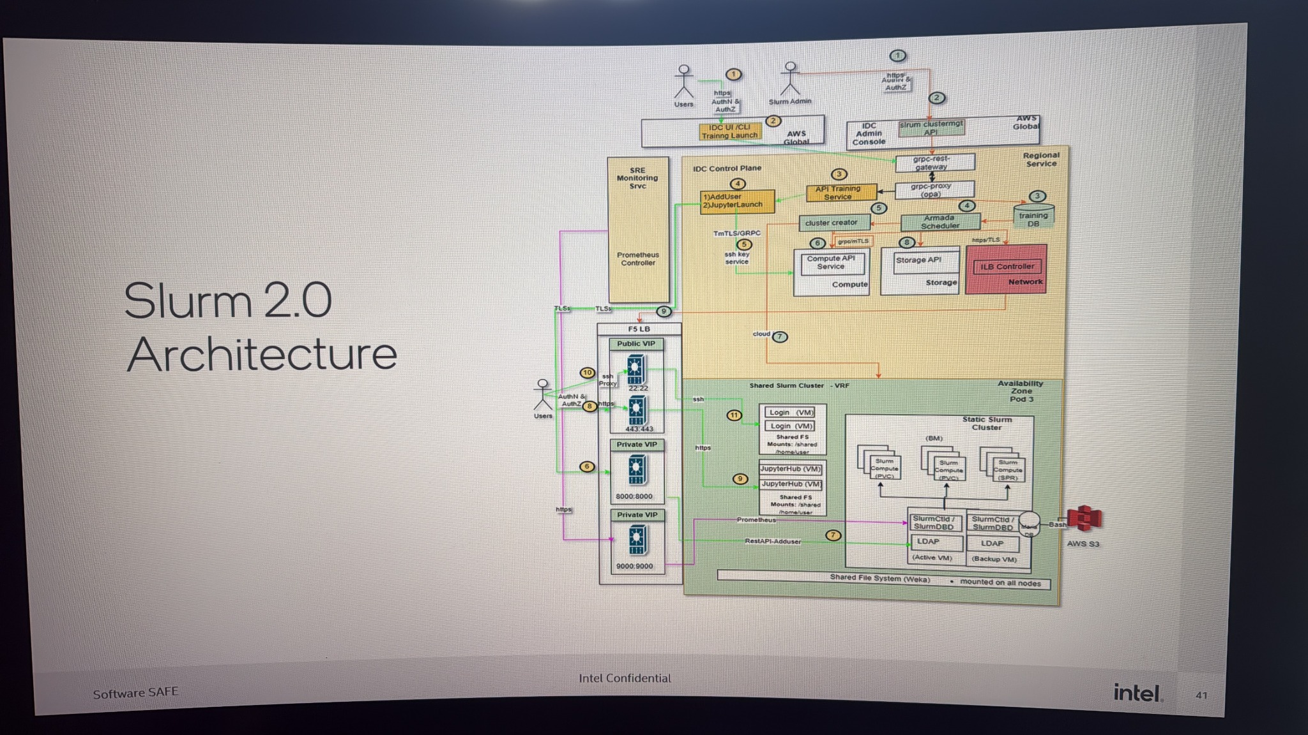
Slurm 2.0 Integration
IDC Control Plane integrates with API Training Service and Prometheus.
Shared Slurm cluster handles Bare Metal + VM nodes.
LDAP for authentication, AWS S3 for data, unified monitoring.
Enables AI + HPC workload orchestration.

Slide 7
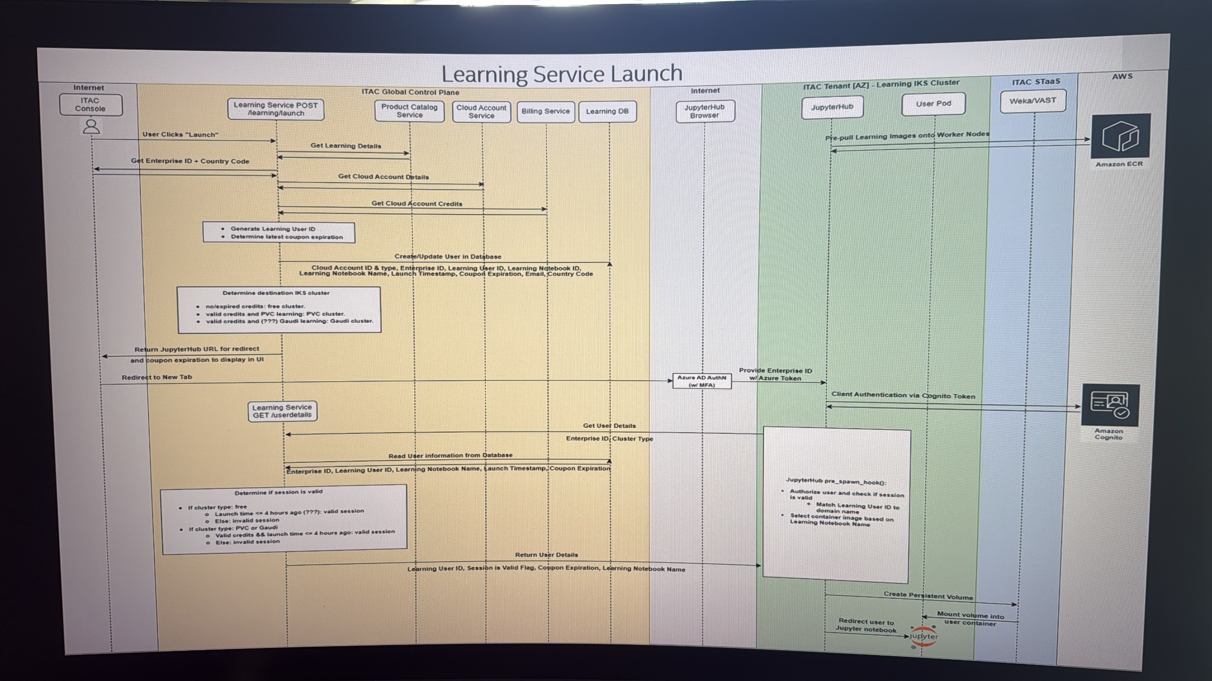
Learning Service Launch Flow
1. User clicks 'Launch' in ITAC Console
2. Fetch cloud account + credits
3. Validate enterprise ID + coupon
4. Pre-pull images to IKS nodes
5. Cognito auth + session creation
6. Mount persistent volume and redirect to JupyterHub.

Slide 8
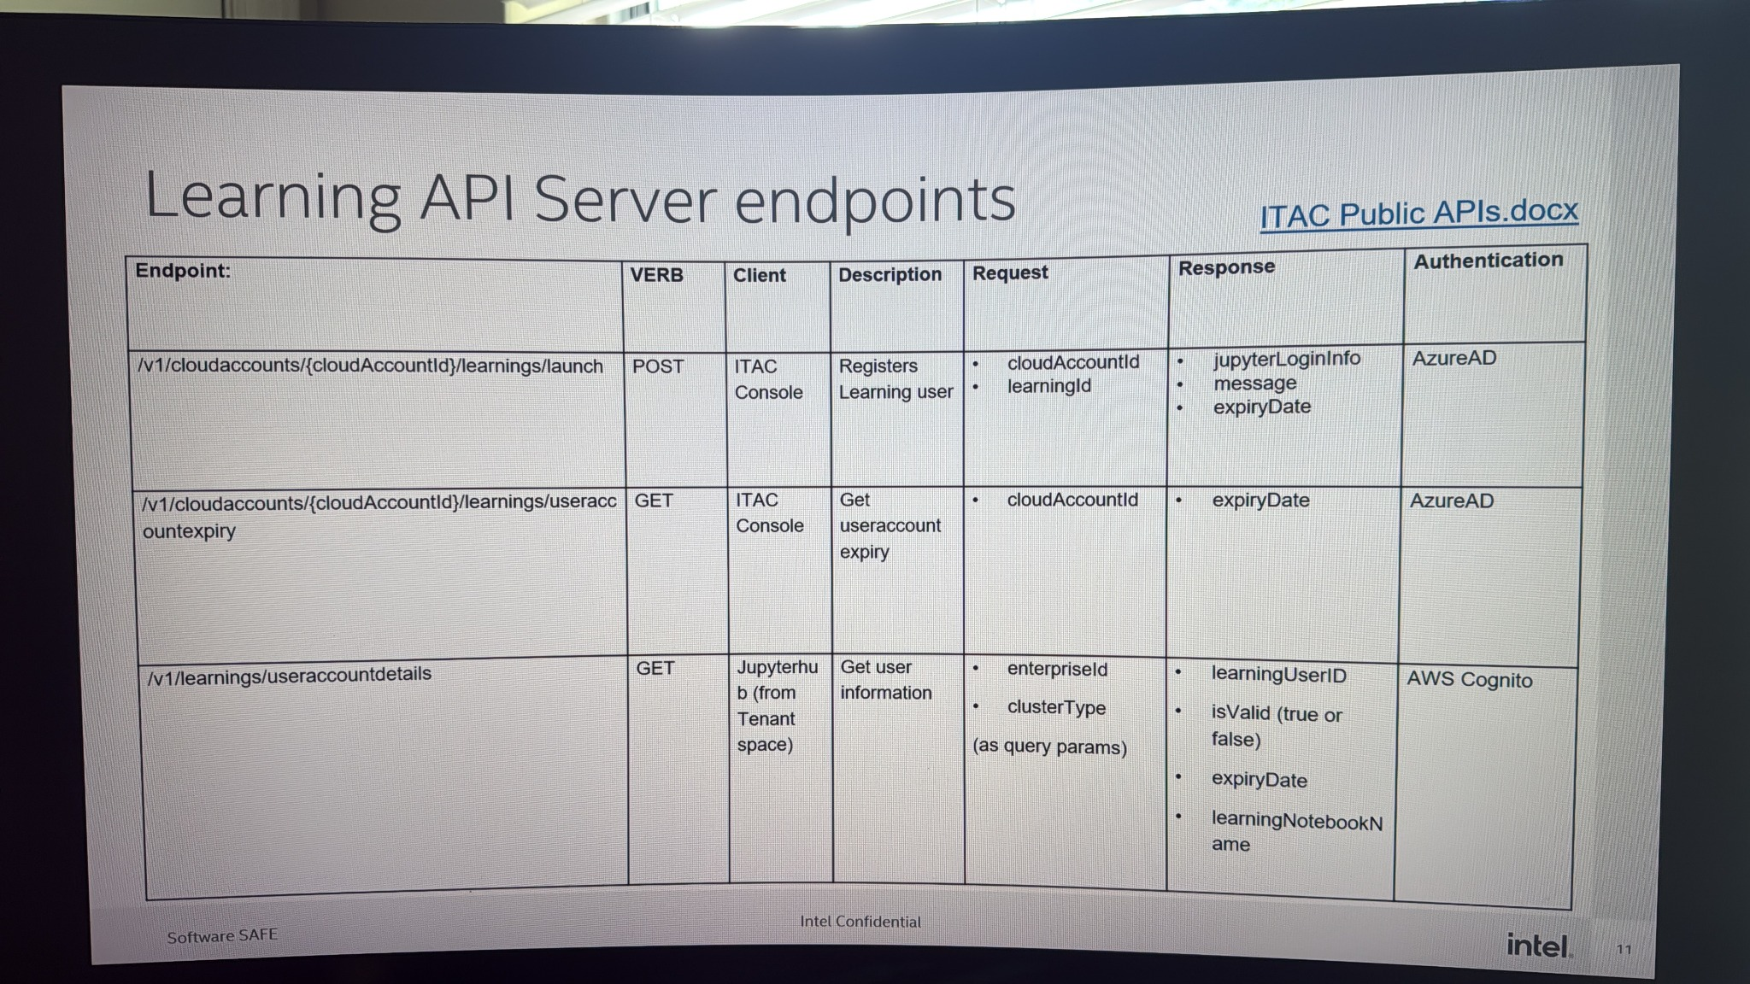
Learning API Endpoints
/v1/cloudaccounts/{id}/learnings/launch - POST (AzureAD)
/v1/cloudaccounts/{id}/learnings/useraccountexpiry - GET (AzureAD)
/v1/learnings/useraccountdetails - GET (AWS Cognito)
Defines standardized service integration points for UI and backend automation.

Slide 9
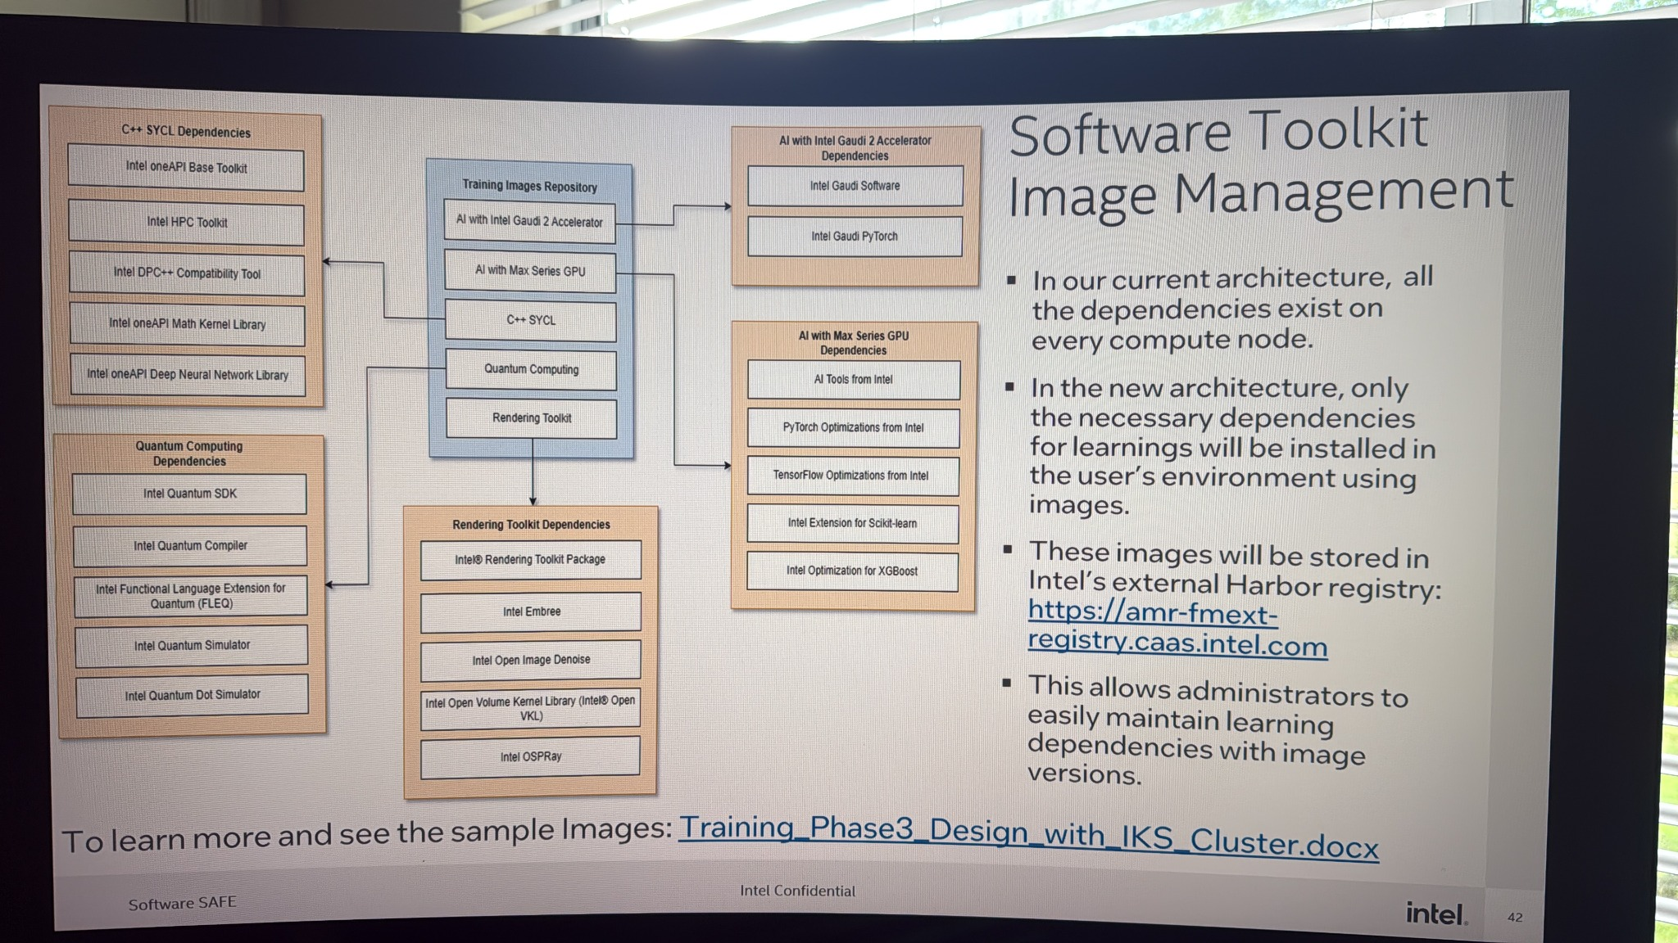
Software Toolkit Image Management
Containerized dependencies reduce per-node overhead.
Toolkits:
- AI: Gaudi2, Max GPU, PyTorch, TensorFlow
- SYCL & oneAPI: HPC/Math Kernel
- Quantum: SDK, Compiler, Simulator
- Rendering: Embree, OSPRay
Images stored in Intel Harbor registry: amr-fmext-registry.caas.intel.com

Slide 10
Key Takeaways
End-to-end automation and isolation in Learning-as-a-Service platform.
mTLS and Cognito integration for secure operations.
Dynamic storage provisioning with CSI (Weka).
Centralized orchestration and telemetry.
Modular dependency management through containerized toolkits.

